Slide 1

MASTER THE TIDYVERSE
Mike K Smith
Winter 2020
Materials used in this course are derived from
https://github.com/rstudio-education/master-the-tidyverse/
and are shared under a CC-BY-SA-4.0 license.

Slide 2


HELLO
my name is
Mike
 @MikeKSmith
MikeKSmith
Mike.K.Smith@Pfizer.com
CC BY-SA RStudio
Notes:
* introduce yourself

Slide 3
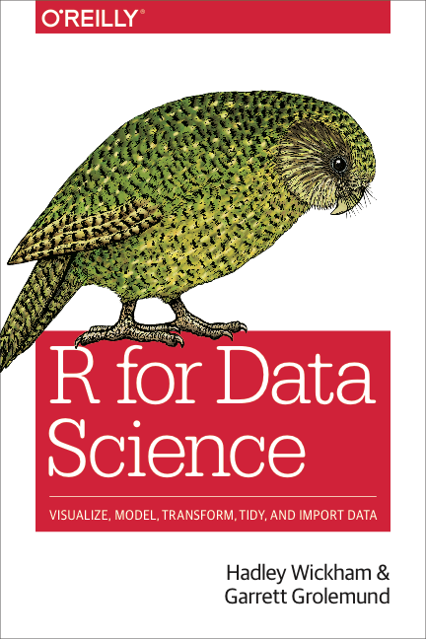
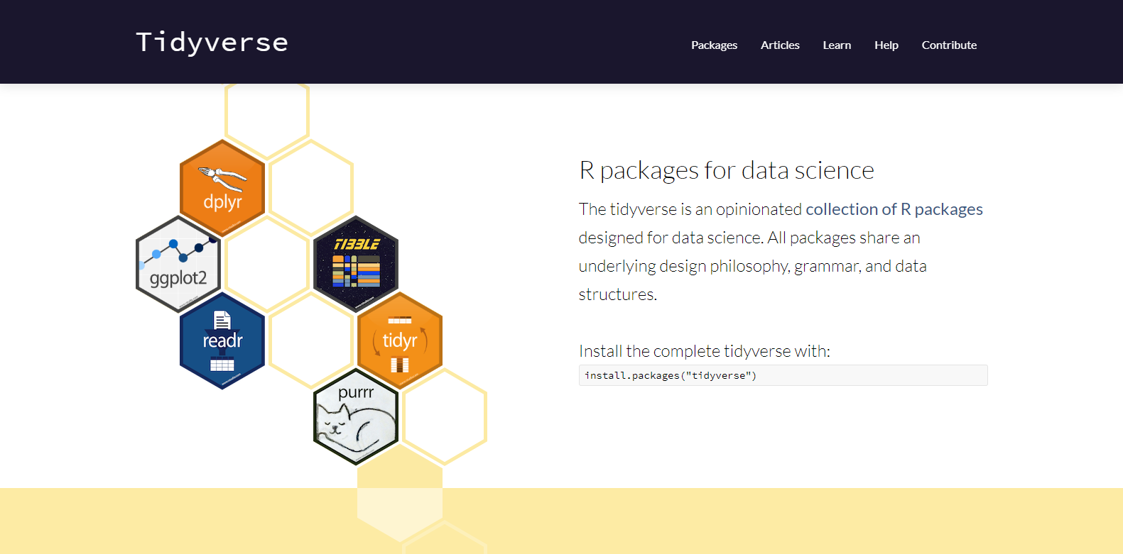
http://tidyverse.org
https://r4ds.had.co.nz/
CC BY-SA RStudio

Slide 4
Introduction and Visualize Data | 17th Jan
Transforming (subsetting) data | 24th Jan
Importing and reshaping data | 31st Jan
Data Types: strings, factors, date-times | 7th Feb
Iteration & Modelling | 14th Feb
Reproducible reporting | 21st Feb
CC BY-SA RStudio

Slide 5


Slide 6
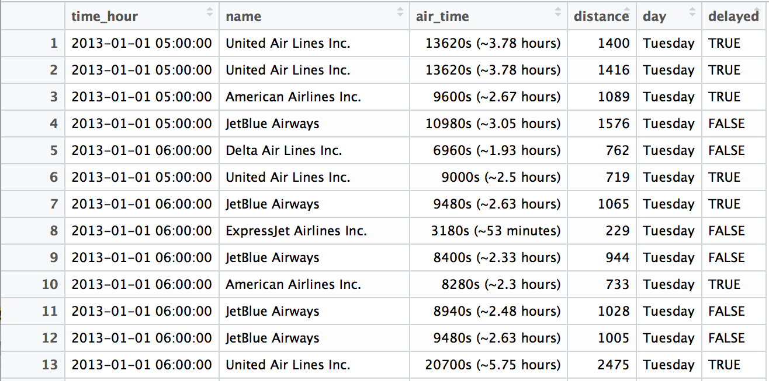
Quiz
What types of data are in this data set?

Slide 7

(Applied) Data Science
Visualize
Import
Tidy
Model
Communicate
Transform
Program
CC BY-SA RStudio

Slide 8
Logicals

Slide 9
Logicals
R's data type for boolean values (i.e. TRUE and FALSE).
typeof(TRUE)
## "logical"
typeof(FALSE)
## "logical"
typeof(c(TRUE, TRUE, FALSE))
## "logical"
CC BY-SA RStudio

Slide 10
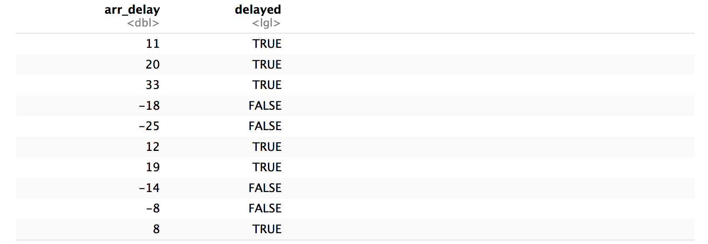
flights %>%
mutate(delayed = arr_delay > 0) %>%
select(arr_delay, delayed)
CC BY-SA RStudio

Slide 11
flights %>%
mutate(delayed = arr_delay > 0) %>%
select(arr_delay, delayed)
Can we compute the proportion of NYC flights that arrived late?
CC BY-SA RStudio

Slide 12
Most useful skills
Math with logicals
CC BY-SA RStudio

Slide 13
Math
When you do math with logicals, TRUE becomes 1 and FALSE becomes 0.
CC BY-SA RStudio

Slide 14
Math
When you do math with logicals, TRUE becomes 1 and FALSE becomes 0.
The sum of a logical vector is the count of TRUEs
sum(c(TRUE, FALSE, TRUE, TRUE))
## 3
CC BY-SA RStudio

Slide 15
Math
When you do math with logicals, TRUE becomes 1 and FALSE becomes 0.
The sum of a logical vector is the count of TRUEs
sum(c(TRUE, FALSE, TRUE, TRUE))
## 3
The mean of a logical vector is the proportion of TRUEs
mean(c(1, 2, 3, 4) < 4)
## 0.75
CC BY-SA RStudio

Slide 16
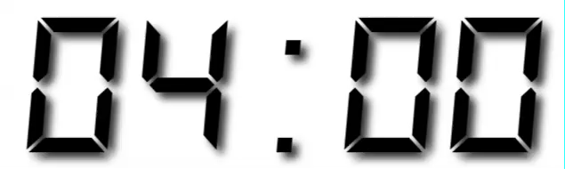
Your Turn 1
Use flights to create delayed, a variable that displays whether a flight was delayed (arr_delay > 0).
Then, remove all rows that contain an NA in delayed.
Finally, create a summary table that shows:
How many flights were delayed
What proportion of flights were delayed

Slide 17
flights %>%
mutate(delayed = arr_delay > 0) %>%
drop_na(delayed) %>%
summarise(total = sum(delayed), prop = mean(delayed))
## # A tibble: 1 × 2
## total prop
## <int> <dbl>
## 1 133004 0.4063101
CC BY-SA RStudio

Slide 18
Strings

Slide 19
(character) strings
Anything surrounded by quotes(") or single quotes(').
> "one"
> "1"
> "one’s"
> '"Hello World"'
> "foo
+
+
+ oops. I’m stuck in a string."
CC BY-SA RStudio

Slide 20
Most useful skills
How to extract/ replace substrings
How to find matches for patterns
Regular expressions
CC BY-SA RStudio

Slide 21


stringr
Simple, consistent functions for working with strings.
# install.packages("tidyverse")
library(stringr)
CC BY-SA RStudio

Slide 22
install.packages("tidyverse")
library("tidyverse")
does the equivalent of
does the equivalent of
install.packages("ggplot2")
install.packages("dplyr")
install.packages("tidyr")
install.packages("readr")
install.packages("purrr")
install.packages("tibble")
install.packages("hms")
install.packages("stringr")
install.packages("lubridate")
install.packages("forcats")
install.packages("DBI")
install.packages("haven")
install.packages("httr")
install.packages("jsonlite")
install.packages("readxl")
install.packages("rvest")
install.packages("xml2")
install.packages("modelr")
install.packages("broom")
library("ggplot2")
library("dplyr")
library("tidyr")
library("readr")
library("purrr")
library("tibble")
CC BY-SA RStudio

Slide 23
install.packages("tidyverse")
library("tidyverse")
does the equivalent of
does the equivalent of
install.packages("ggplot2")
install.packages("dplyr")
install.packages("tidyr")
install.packages("readr")
install.packages("purrr")
install.packages("tibble")
install.packages("hms")
install.packages("stringr")
install.packages("lubridate")
install.packages("forcats")
install.packages("DBI")
install.packages("haven")
install.packages("httr")
install.packages("jsonlite")
install.packages("readxl")
install.packages("rvest")
install.packages("xml2")
install.packages("modelr")
install.packages("broom")
library("ggplot2")
library("dplyr")
library("tidyr")
library("readr")
library("purrr")
library("tibble")
CC BY-SA RStudio

Slide 24
Example data
[1] "." "EGmb_150_mg/day_(BID)"
[3] "EGmb_300_mg/day_(BID)" "EGmb_50_mg/day_(BID)"
[5] "EGmb_600_mg/day_(BID)" "Placebo"
[7] "examplumab_10mg/kg/day" "examplumab_150_mg/day(TID)"
[9] "examplumab_15mg/kg/day" "examplumab_2.5mg/kg/day"
[11] "examplumab_5mg/kg/day" "EXAMPLUMAB_600_mg/day(TID)"
[13] "EXAMPLUMAB_600_mg/day_(BID)" "EXAMPLUMAB_600_mg/day_(TID)"
[15] "examplumab_Level_1_2.5_mg/kg/day_[max_150_mg/day_BID]" "examplumab_Level_2_10_mg/kg/day_[max_600_mg/day_BID]"

Slide 25
str_sub()
Extract or replace portions of a string with str_sub()
str_sub(string, start = 1, end = -1)
string(s) to manipulate
position of first character to extract within each string
position of last character to extract within each string
CC BY-SA RStudio

Slide 26
Quiz
What will this return?
str_sub("Examplumab", 1, 2)
"Ex"

Slide 27
Quiz
What will this return?
str_sub("Examplumab", 1, 1)
"E"

Slide 28
Quiz
What will this return?
str_sub("Examplumab", 2)
"xamplumab"

Slide 29
Quiz
What will this return?
str_sub("Examplumab", -3)
"mab"

Slide 30
Quiz
What will this return?
s <- "Examplumab"
str_sub(s, 1,2) <- "ex"
"examplumab"

Slide 31
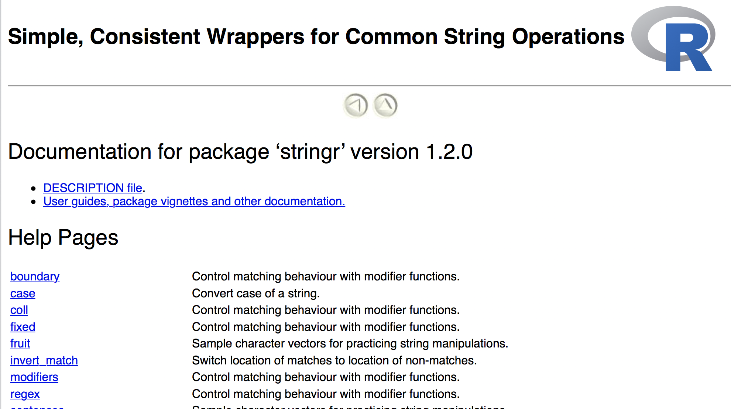
help(package = stringr)
CC BY-SA RStudio

Slide 32
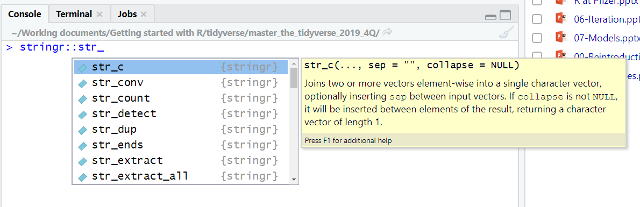
In the RStudio Console, start typing “str_” and hit TAB
CC BY-SA RStudio

Slide 33
str_detect()
Test whether a pattern appears within a string.
str_detect(string, pattern)
vector of strings to find patterns in
a string that represents a regular expression
CC BY-SA RStudio

Slide 34
Quiz
What will this return?
strings <- c("Examplumab", "examplumab", "Egmb")
str_detect(strings, "mab")
TRUE, TRUE, FALSE

Slide 35
Quiz
What will this return?
strings <- c("Examplumab", "examplumab", "Egmb")
str_detect(strings, “Exampl")
TRUE FALSE FALSE

Slide 36
Quiz
What will this return?
strings <- c("Examplumab", "examplumab", "Egmb")
str_detect(strings,
regex("exampl", ignore_case=TRUE))
TRUE TRUE FALSE

Slide 37
word( )
Returns the <nth> word within a string.
word(string, start = 1, end = -1, sep = " ")
character string to find words in
position of first “word” to extract within each string
position of last “word” to extract within each string
Separating character between “words”
CC BY-SA RStudio

Slide 38
Quiz
What will this return?
string <- “examplumab 10mg/kg/day"
word(string, 1)
examplumab

Slide 39
Quiz
What will this return?
string <- “examplumab 10mg/kg/day"
word(string, start = -1)
10mg/kg/day

Slide 40
Quiz
What will this return?
string <- "examplumab_150mg/day_(BID)"
word(string, start = -1, sep="_")
(BID)

Slide 41
str_extract( )
Returns the part of strings that match the pattern.
str_extract(string, pattern)
character string to search in
pattern to search for
CC BY-SA RStudio

Slide 42
Quiz
How to detect and extract numeric values in a string?
string <- "examplumab_150mg/day_(BID)"
str_extract(string, "[:digit:]mg")
0mg

Slide 43
Quiz
How to detect and extract numeric values in a string?
string <- "examplumab_150mg/day_(BID)"
str_extract(string, "[:digit:]+mg")
150mg

Slide 44
regular expressions
regex is a "language" for describing a pattern of characters, with patterns of characters, e.g. [:digit:]+mg
Find out more at :
https://stringr.tidyverse.org/articles/regular-expressions.html
string <- "150mg_bid"
str_extract_all(string, "[:alnum:]+")
[1] "150mg bid"
CC BY-SA RStudio

Slide 45
str_replace( )
Replaces (parts) of a string that match a pattern
str_replace(string, pattern, replacement)
character string to search in
pattern to search for
replace pattern with new characters
CC BY-SA RStudio

Slide 46
Quiz
What difference will str_replace make here?
string <- "examplumab_150mg_bid"
str_replace(string, "_", " ")
examplumab 150mg_bid

Slide 47
str_replace_all( )
Replaces each occurrence of a string that match a pattern
str_replace_all(string, pattern, replacement)
character string to search in
pattern to search for
replace pattern with new characters
CC BY-SA RStudio

Slide 48
Quiz
What difference will str_replace_all make here?
string <- "examplumab_150mg_bid" str_replace_all(string, "_", " ")
examplumab 150mg bid

Slide 49
str_subset( )
Finds occurrences of a pattern within a string
str_subset(string, pattern)
character string to search in
pattern to search for
CC BY-SA RStudio

Slide 50
Quiz
What will this return?
strings <- c("Examplumab", "examplumab", "Egmb")
str_subset(strings,
regex("examplumab", ignore_case=TRUE))
"Examplumab", "examplumab"

Slide 51
tolower, toupper
From base R, these function change case.
tolower("EXAMPLUMAB")
[1] "examplumab"
toupper("Examplumab")
[1] "EXAMPLUMAB"
CC BY-SA RStudio

Slide 52
tools::toTitleCase
tools::toTitleCase("My fabulous title")
[1] "My Fabulous Title"
CC BY-SA RStudio

Slide 53
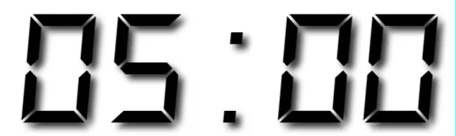
Your Turn 2
Use the str_ functions to clean up the vector of treatment information.
Make the treatment names consistent i.e. all lower case, consistent drug names i.e. change “Egmb” to “examplumab”.
Extract the treatment names i.e. “placebo” and “examplumab”.
Try to extract dosing information e.g. 10mg/kg/day.
How many distinct treatments are there?

Slide 54
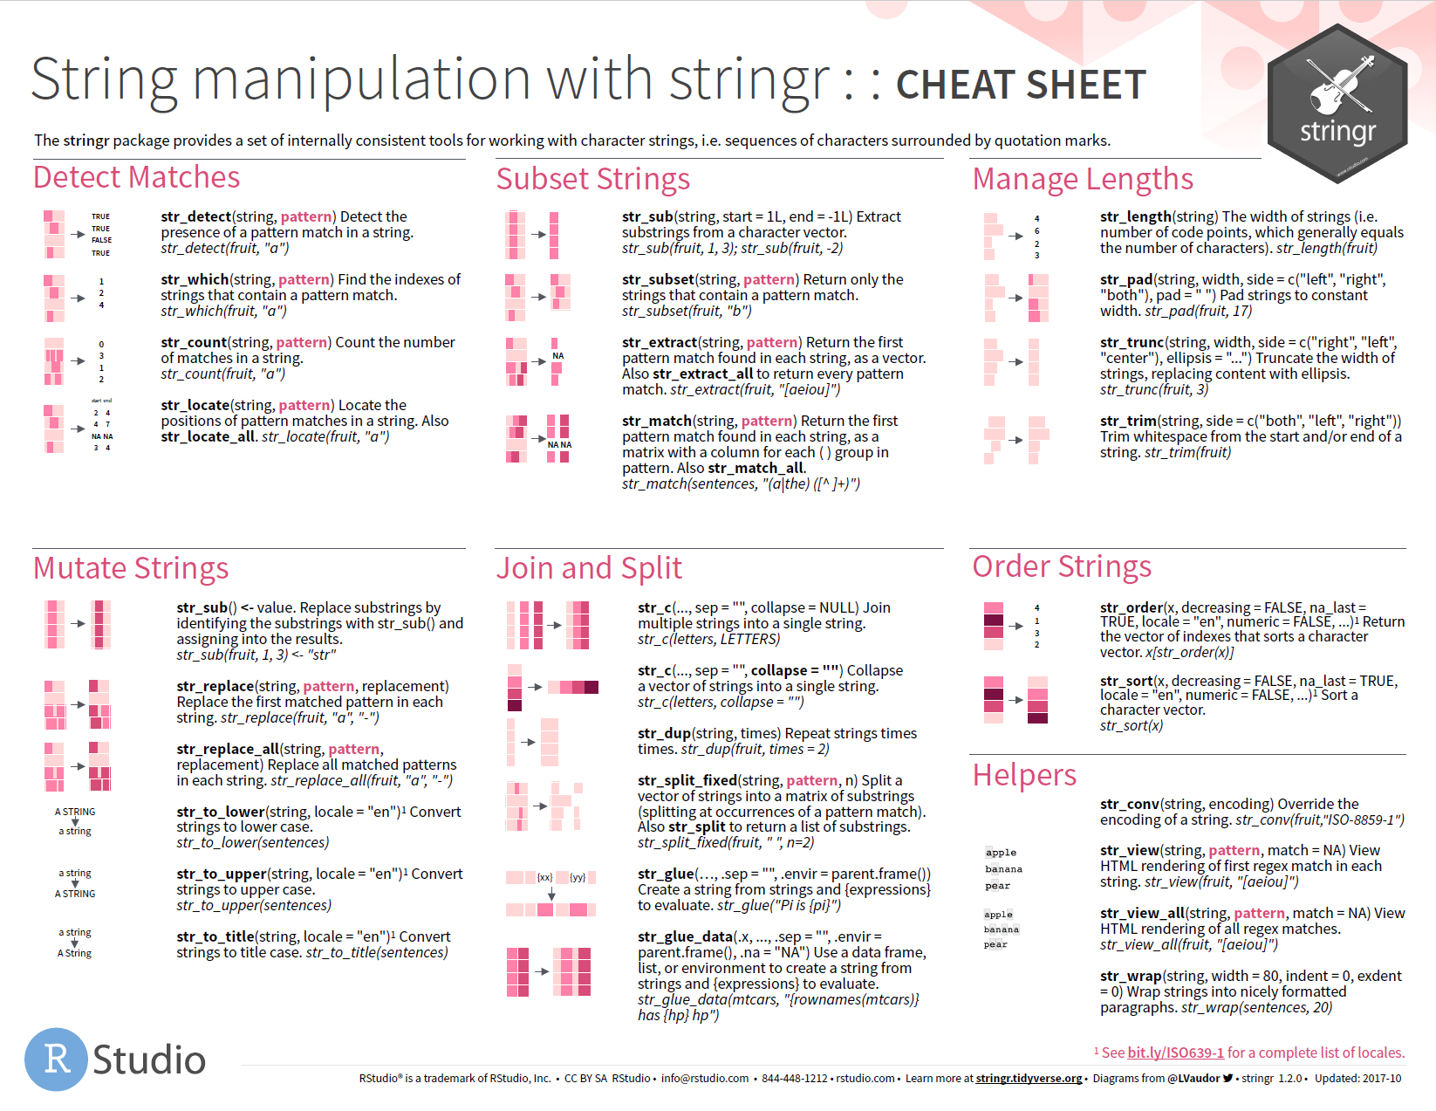

Slide 55
Quiz
What will this return?
"AC\DC"

Slide 56
Quiz
What will this return?
"AC\DC"
Error: '\D' is an unrecognized escape in character string starting ""AC\D"

Slide 57
special characters
A backslash followed by one or more characters which stand for a special type of character.
Use writeLines() to see the characters represented by a string.
## Use an escape to include a special character
writeLines("\"")
## "
writeLines("\\")
## \
A string is not a
sequence of characters itself, but a representation of a sequence of characters
CC BY-SA RStudio

Slide 58
writeLines("AC\\DC")
## AC\DC
CC BY-SA RStudio

Slide 59
Quiz
What will this return?
str_detect("AC\\DC", "\\")
Error in stri_detect_regex(string, pattern, opts_regex = opts(pattern)) :
Unrecognized backslash escape sequence in pattern. (U_REGEX_BAD_ESCAPE_SEQUENCE)

Slide 60
writeLines("\\")
## \
This is not a valid regular expression
(looks like an incomplete special character)
CC BY-SA RStudio

Slide 61
We want to find this
\
…which is represented by this regex
\\
…which is represented by this string
Write your patterns at this level
"\\\\"
CC BY-SA RStudio

Slide 62
We want to find this
?
…which is represented by this regex
\?
…which is represented by this string
"\\?"
CC BY-SA RStudio

Slide 63
We want to find this
abc
…which is represented by this regex
abc
…which is represented by this string
"abc"
CC BY-SA RStudio

Slide 64
Your Turn 2 (and a bit)
Subset out the treatment labels have decimal dose values
(HINTS: regex pattern \\d finds numeric values; `+` finds 1 or more
instances of some pattern)

Slide 65
myTrts %>%
str_subset(pattern = "\\d+\\.+\\d+")
[1] "examplumab_2.5mg/kg/day"
[2] "examplumab_Level_1_2.5_mg/kg/day_[max_150_mg/day_BID]"
CC BY-SA RStudio

Slide 66
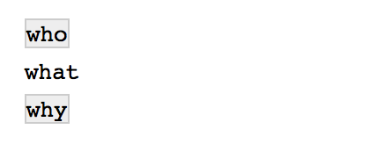
str_view()
Displays the matches of a regular expression in the Viewer pane
str_view(c("who", "what", "why"), "\\w*[aeiouy]\\b")
CC BY-SA RStudio

Slide 67

Factors

Slide 68
factors
R’s representation of categorical data. Consists of:
A set of values
An ordered set of valid levels
eyes <- factor(x = c("blue", "green", "green"),
levels = c("blue", "brown", "green"))
eyes
## [1] blue green green
## Levels: blue brown green
CC BY-SA RStudio

Slide 69
factors
Stored as an integer vector with a levels attribute
unclass(eyes)
## 1 3 3
## attr(,"levels")
## "blue" "brown" "green"
CC BY-SA RStudio

Slide 70
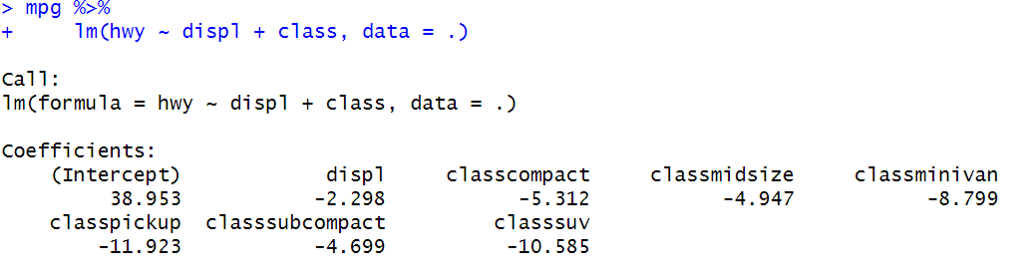
factors
WHY? Statistical models.
If you include a categorical covariate with 2 or more levels then you need to tell the model which level is the reference level.
QUESTION: Which vehicle class is the reference in the model below? Is it a good reference category?
CC BY-SA RStudio

Slide 71
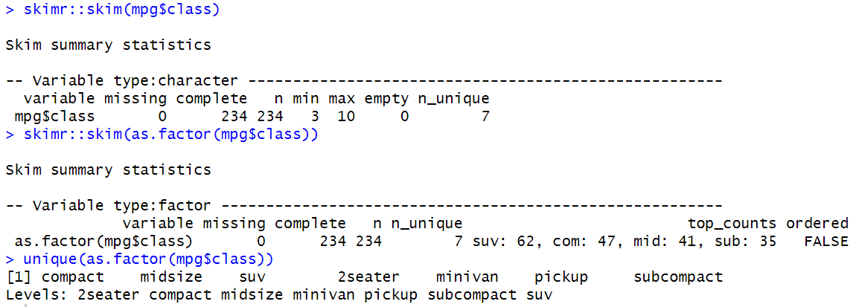
factors
Quick change to factor: as.factor(<variable>)
CC BY-SA RStudio

Slide 72
factors
Factor ordering can help organise data for tables and figures:
Tx <- c("Egmb 10mg","Egmb 5mg", "Pbo")
sort(Tx)
## [1] "Egmb 10mg" "Egmb 5mg" "Pbo"
TxFac <- factor(Tx,
levels=c("Pbo","Egmb 5mg","Egmb 10mg"),
labels = c("Placebo",
"Examplumab 5mg",
"Examplumab 10mg")
## [1] Examplumab 10mg Examplumab 5mg Placebo
Levels: Placebo Examplumab 5mg Examplumab 10mg
CC BY-SA RStudio

Slide 73

forcats
Anagram!
Simple functions for working with factors.
# install.packages("tidyverse")
library(forcats)
CC BY-SA RStudio

Slide 74
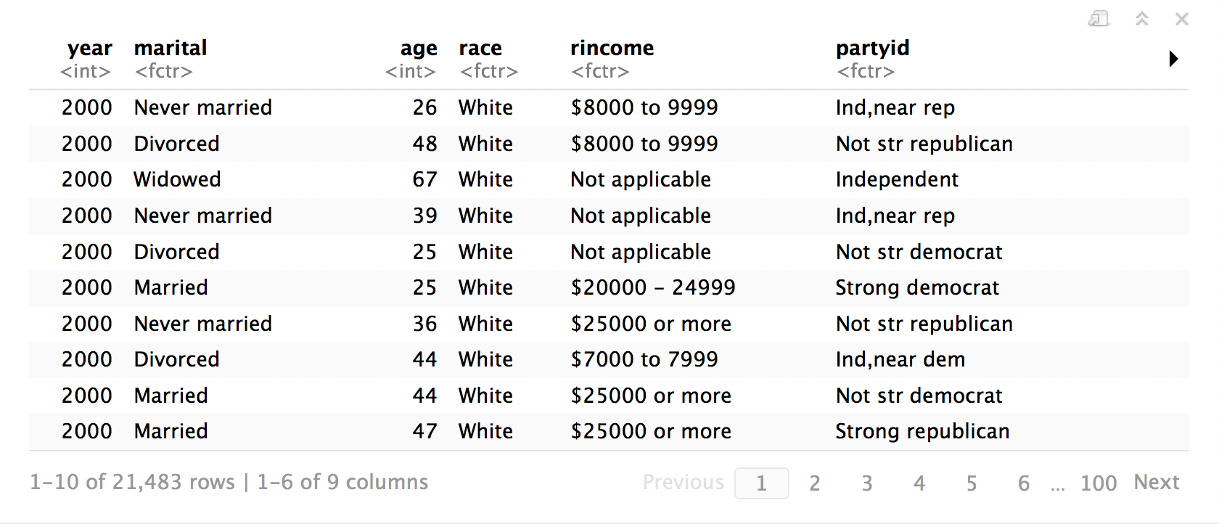
gss_cat
library(forcats)
gss_cat
A sample of data from the General Social Survey, a long-running US survey conducted by NORC at the University of Chicago.
CC BY-SA RStudio

Slide 75
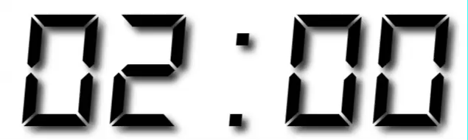
Warm Up
Decide in your group:
Which religions watch the least TV?
Do married people watch more or less TV than single people?

Slide 76
Which religions watch the least TV?
gss_cat %>%
drop_na(tvhours) %>%
group_by(relig) %>%
summarise(tvhours = mean(tvhours)) %>%
ggplot(aes(tvhours, relig)) +
geom_point()
CC BY-SA RStudio

Slide 77
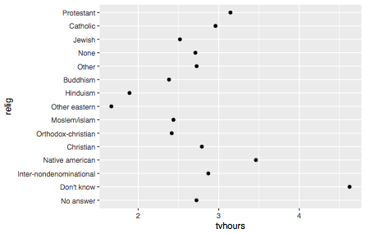
CC BY-SA RStudio

Slide 78
Why is the Y axis in this order?
CC BY-SA RStudio

Slide 79
levels()
Use levels() to access a factor’s levels
levels(gss_cat$relig)
## [1] "No answer" "Don't know"
## [3] "Inter-nondenominational" "Native american"
## [5] "Christian" "Orthodox-christian"
## [7] "Moslem/islam" "Other eastern"
## [9] "Hinduism" "Buddhism"
## [11] "Other" "None"
## [13] "Jewish" "Catholic"
## [15] "Protestant" "Not applicable"
CC BY-SA RStudio

Slide 80
Why is the Y axis in this order?
Because the
levels of relig have this order
CC BY-SA RStudio

Slide 81
Most useful skills
Reorder the levels
Recode the levels
Collapse levels
CC BY-SA RStudio

Slide 82
Reordering
levels

Slide 83
fct_reorder()
Reorders the levels of a factor based on the result of fun(x) applied to each group of cases (grouped by level).
fct_reorder(f, x, fun = median, …, .desc = FALSE)
factor to reorder
variable to reorder by
(in conjunction with fun)
function to reorder by
(in conjunction with x)
put in descending order?
CC BY-SA RStudio

Slide 84
gss_cat %>%
drop_na(tvhours) %>%
group_by(relig) %>%
summarise(tvhours = mean(tvhours)) %>%
ggplot(aes(tvhours, fct_reorder(relig, tvhours))) +
geom_point()
CC BY-SA RStudio

Slide 85
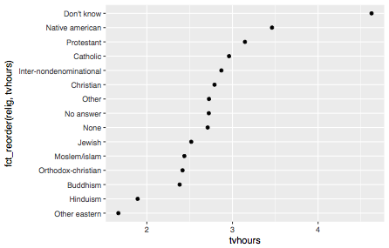
CC BY-SA RStudio

Slide 86
Your Turn 3
Repeat the previous exercise, some of whose code is in your notebook, to make a sensible graph of average TV consumption by marital status.

Slide 87
gss_cat %>%
drop_na(tvhours) %>%
group_by(marital) %>%
summarise(tvhours = mean(tvhours)) %>%
ggplot(aes(tvhours, fct_reorder(marital, tvhours))) +
geom_point()
CC BY-SA RStudio

Slide 88
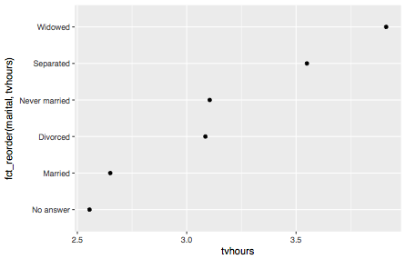
CC BY-SA RStudio

Slide 89
fct_reorder2()
Reorders the levels of a factor by the Y values associated with the largest X values.
fct_reorder2(f, x, y, fun = last2, …, .desc = FALSE)
X variable
Y variable
CC BY-SA RStudio

Slide 90
gss_cat %>%
drop_na(age) %>%
group_by(age, marital) %>%
count() %>%
group_by(age) %>%
mutate(prop = n / sum(n)) %>%
ggplot(aes(age, prop, color = marital)) +
geom_line()
CC BY-SA RStudio

Slide 91
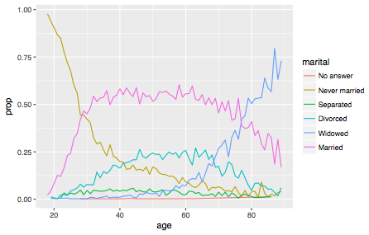
Proportion who report each marital status by age
CC BY-SA RStudio

Slide 92
gss_cat %>%
drop_na(age) %>%
group_by(age, marital) %>%
count() %>%
mutate(prop = n / sum(n)) %>%
ggplot(aes(age, prop),
color = fct_reorder2(marital, age, prop)) +
geom_line()
CC BY-SA RStudio

Slide 93
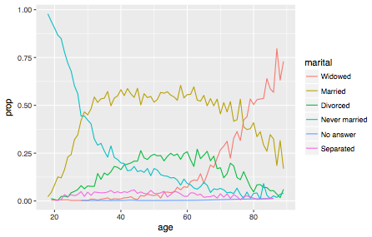
CC BY-SA RStudio

Slide 94
Similar reordering functions

Slide 95
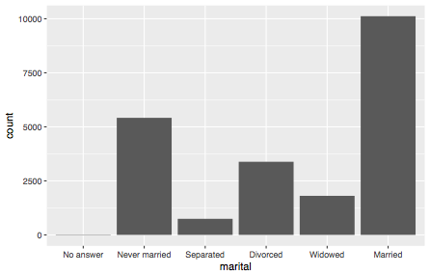
gss_cat %>%
ggplot(aes(marital)) + geom_bar()
CC BY-SA RStudio

Slide 96
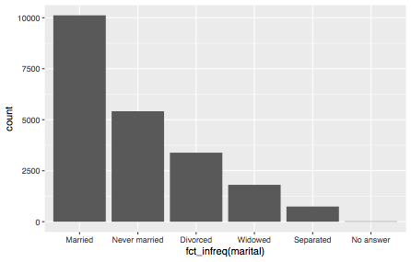
fct_infreq
gss_cat %>%
ggplot(aes(fct_infreq(marital))) + geom_bar()
CC BY-SA RStudio

Slide 97
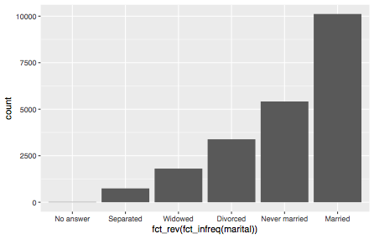
fct_rev
gss_cat %>%
ggplot(aes(fct_rev(fct_infreq(marital)))) + geom_bar()
CC BY-SA RStudio

Slide 98
Changing
level values

Slide 99
Your Turn 4
Do you think liberals or conservatives watch more TV?
Compute average tv hours by party ID an then plot the results.

Slide 100
gss_cat %>%
drop_na(tvhours) %>%
group_by(partyid) %>%
summarise(tvhours = mean(tvhours)) %>%
ggplot(aes(tvhours, fct_reorder(partyid, tvhours))) +
geom_point() +
labs(y = "partyid")
CC BY-SA RStudio

Slide 101
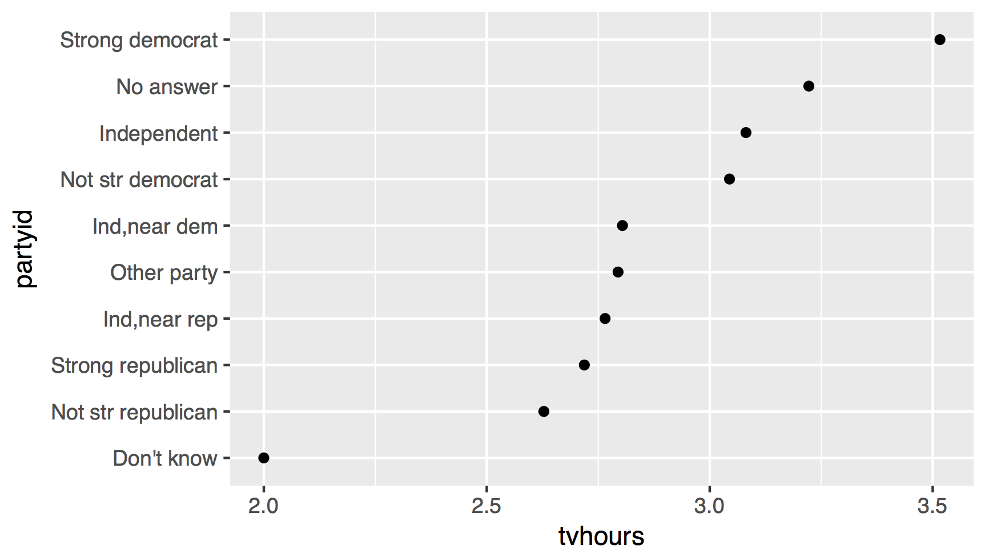
1. How can we improve these labels?
CC BY-SA RStudio

Slide 102
fct_recode()
Changes values of levels
fct_recode(f, …)
factor with levels
new level = old level pairs (as a named character vector)
CC BY-SA RStudio

Slide 103
gss_cat %>%
drop_na(tvhours) %>%
mutate(partyid = fct_recode(partyid,
"Republican, strong" = "Strong republican",
"Republican, weak" = "Not str republican",
"Independent, near rep" = "Ind,near rep",
"Independent, near dem" = "Ind,near dem",
"Democrat, weak" = "Not str democrat",
"Democrat, strong" = "Strong democrat")) %>%
group_by(partyid) %>%
summarise(tvhours = mean(tvhours)) %>%
ggplot(aes(tvhours, fct_reorder(partyid, tvhours))) +
geom_point() + labs(y = "partyid")
CC BY-SA RStudio

Slide 104
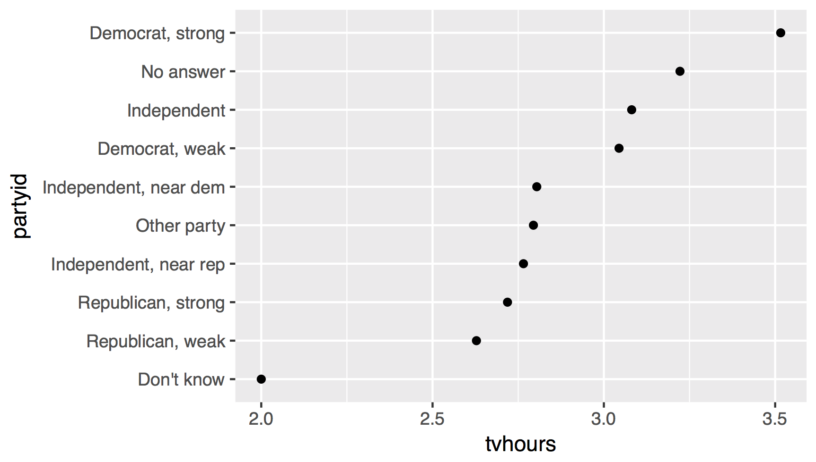
liberal
liberal
liberal
conservative
2. How can we combine these groups?
conservative
conservative
CC BY-SA RStudio

Slide 105
Collapsing
levels

Slide 106
fct_collapse()
Changes multiple levels into single levels
fct_collapse(f, …)
factor with levels
named arguments set to a character vector (levels in the vector will be collapsed to the name of the argument)
CC BY-SA RStudio

Slide 107
gss_cat %>%
drop_na(tvhours) %>%
mutate(partyid = fct_collapse(partyid,
conservative = c("Strong republican",
"Not str republican",
"Ind,near rep"),
liberal = c("Strong democrat",
"Not str democrat",
"Ind,near dem"))) %>%
group_by(partyid) %>%
summarise(tvhours = mean(tvhours)) %>%
ggplot(aes(tvhours, fct_reorder(partyid, tvhours))) +
geom_point() + labs(y = "partyid")
CC BY-SA RStudio

Slide 108
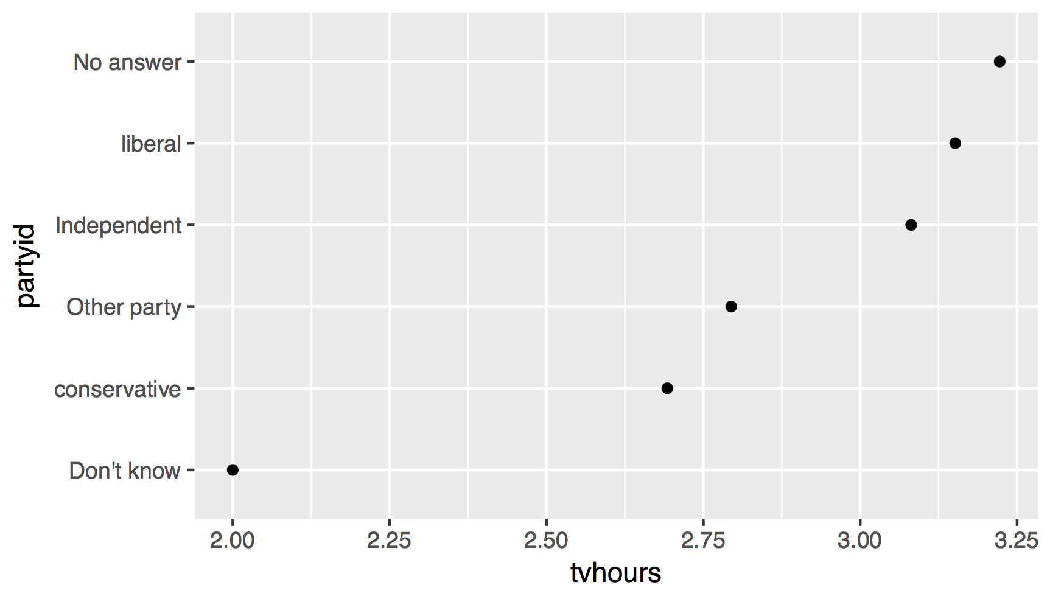
There are relatively few points in each of these groups
CC BY-SA RStudio

Slide 109
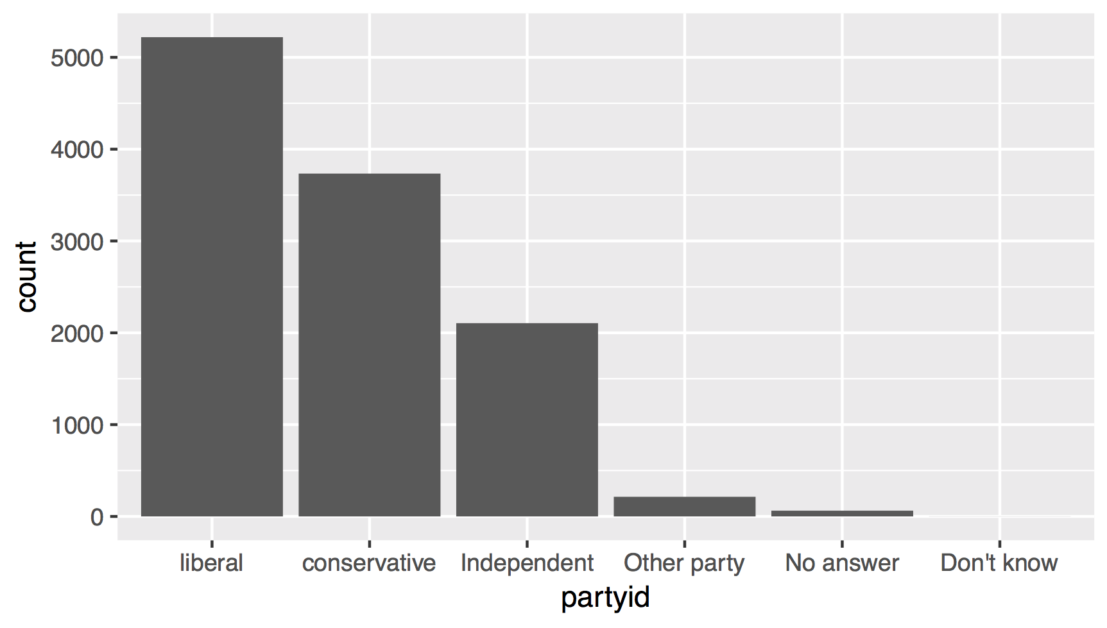
CC BY-SA RStudio

Slide 110
fct_lump()
Collapses levels with fewest values into a single level. By default collapses as many levels as possible such that the new level is still the smallest.
fct_lump(f, other_level = "Other", …)
factor with levels
name of new level
CC BY-SA RStudio

Slide 111
gss_cat %>%
drop_na(tvhours) %>%
mutate(partyid = partyid %>%
fct_collapse(
conservative = c("Strong republican",
"Not str republican", "Ind,near rep"),
liberal = c("Strong democrat", "Not str democrat",
"Ind,near dem")) %>%
fct_lump()
) %>%
group_by(partyid) %>%
summarise(tvhours = mean(tvhours)) %>%
ggplot(aes(tvhours, fct_reorder(partyid, tvhours))) +
geom_point() + labs(y = "partyid")
CC BY-SA RStudio

Slide 112
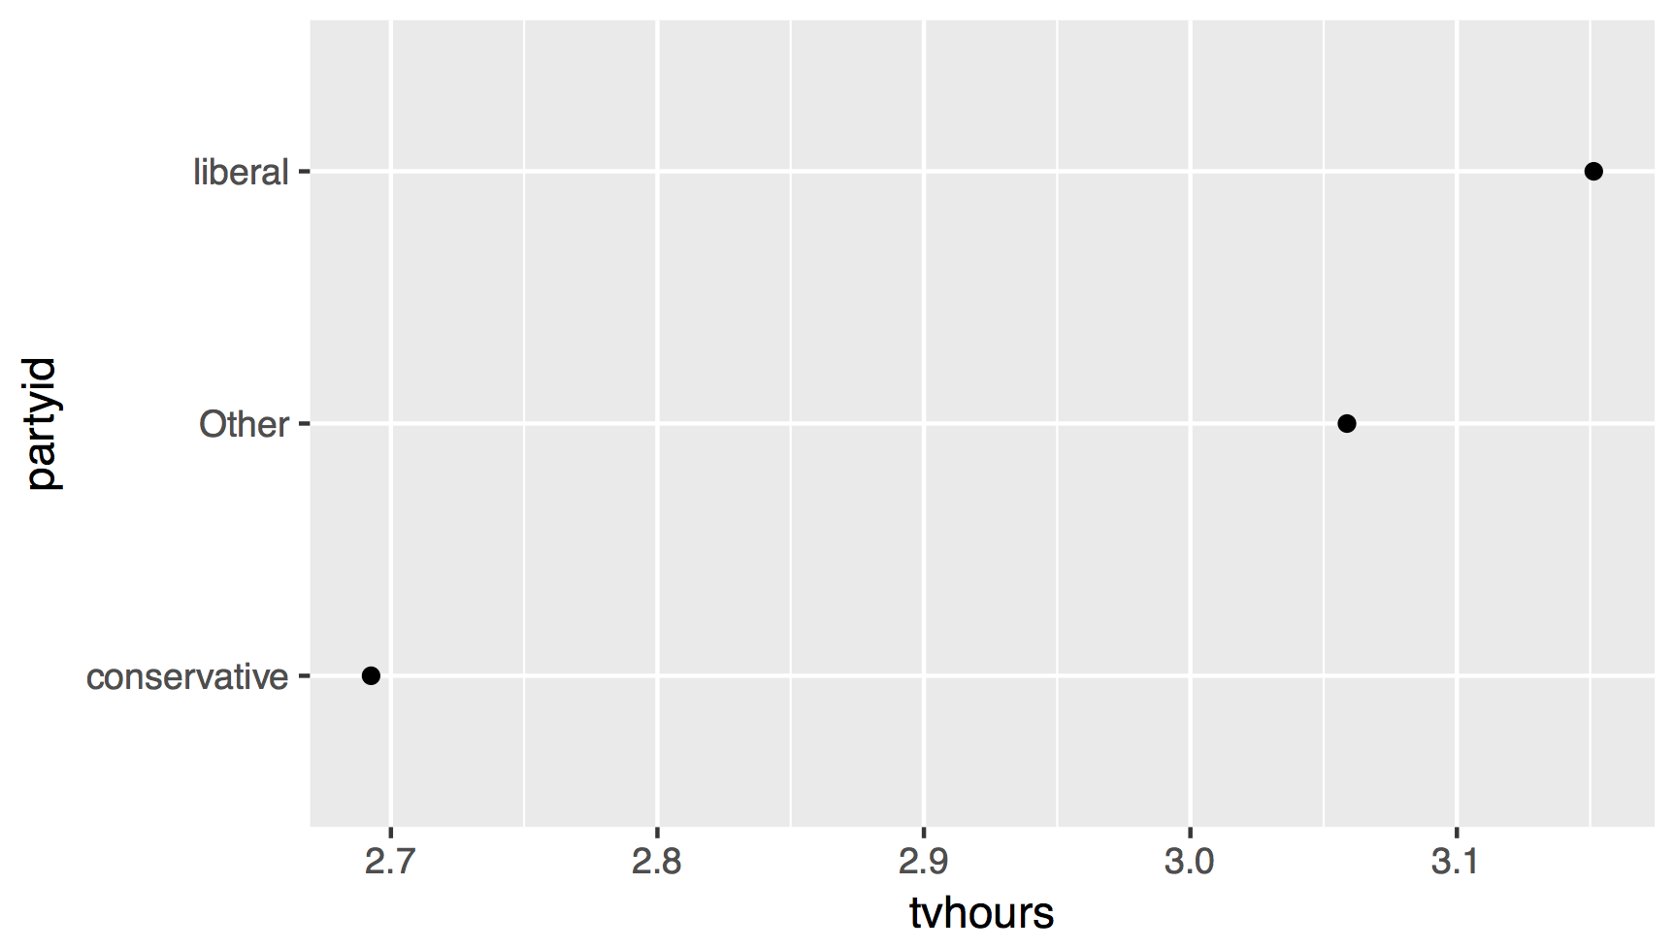
CC BY-SA RStudio

Slide 113
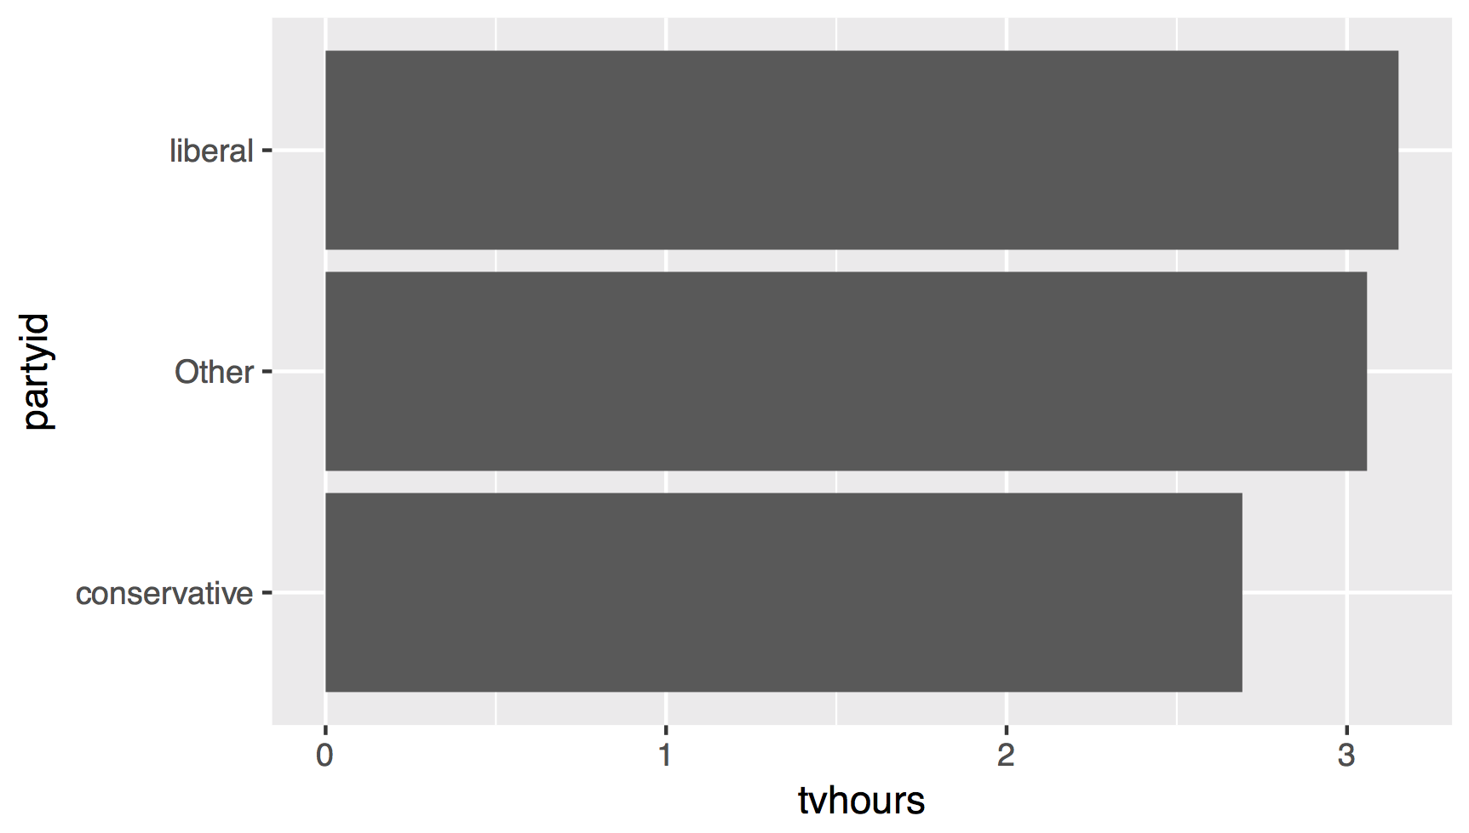
CC BY-SA RStudio

Slide 114
gss_cat %>%
drop_na(tvhours) %>%
mutate(partyid = partyid %>%
fct_collapse(
conservative = c("Strong republican",
"Not str republican", "Ind,near rep"),
liberal = c("Strong democrat", "Not str democrat",
"Ind,near dem")) %>%
fct_lump()
) %>%
group_by(partyid) %>%
summarise(tvhours = mean(tvhours)) %>%
ggplot(aes(fct_reorder(partyid, tvhours), tvhours)) +
geom_col() + labs(x = "partyid") + coord_flip()
CC BY-SA RStudio

Slide 115
Date times

Slide 116
Quiz
Does every year have 365 days?

Slide 117
Quiz
Does every day have 24 hours?

Slide 118
Quiz
What does a month measure?

Slide 119

Dates and times involve:
instants - specific moments in time (e.g., Jan 1, 2017)
time spans - spans of time (e.g., a day)
CC BY-SA RStudio

Slide 120
Most useful skills
Creating dates/times (i.e. parsing)
Access and change parts of a date
Deal with time zones
Do math with instants and time spans
CC BY-SA RStudio

Slide 121

Warm Up
Decide in your group:
What is the best time of day to fly?
What is the best day of the week to fly?

Slide 122
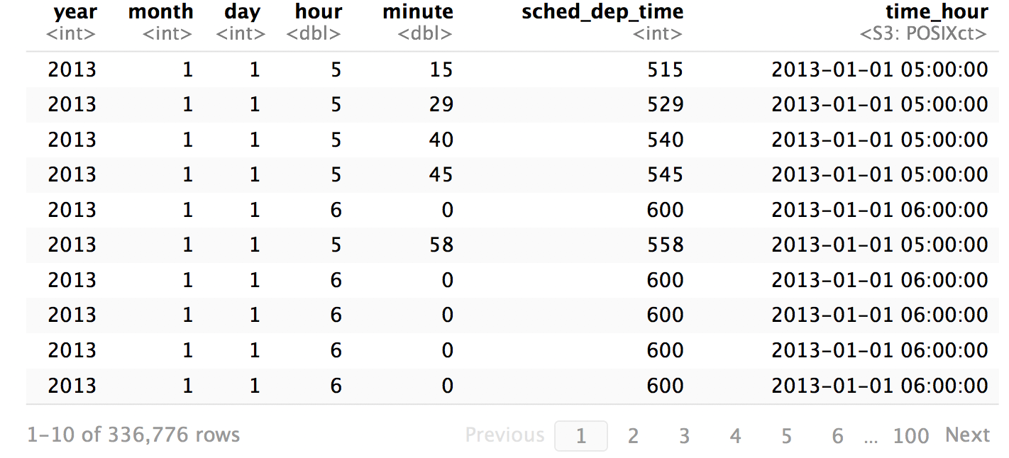
flights %>% select(c(1, 2, 3, 17, 18, 5, 19))
CC BY-SA RStudio

Slide 123
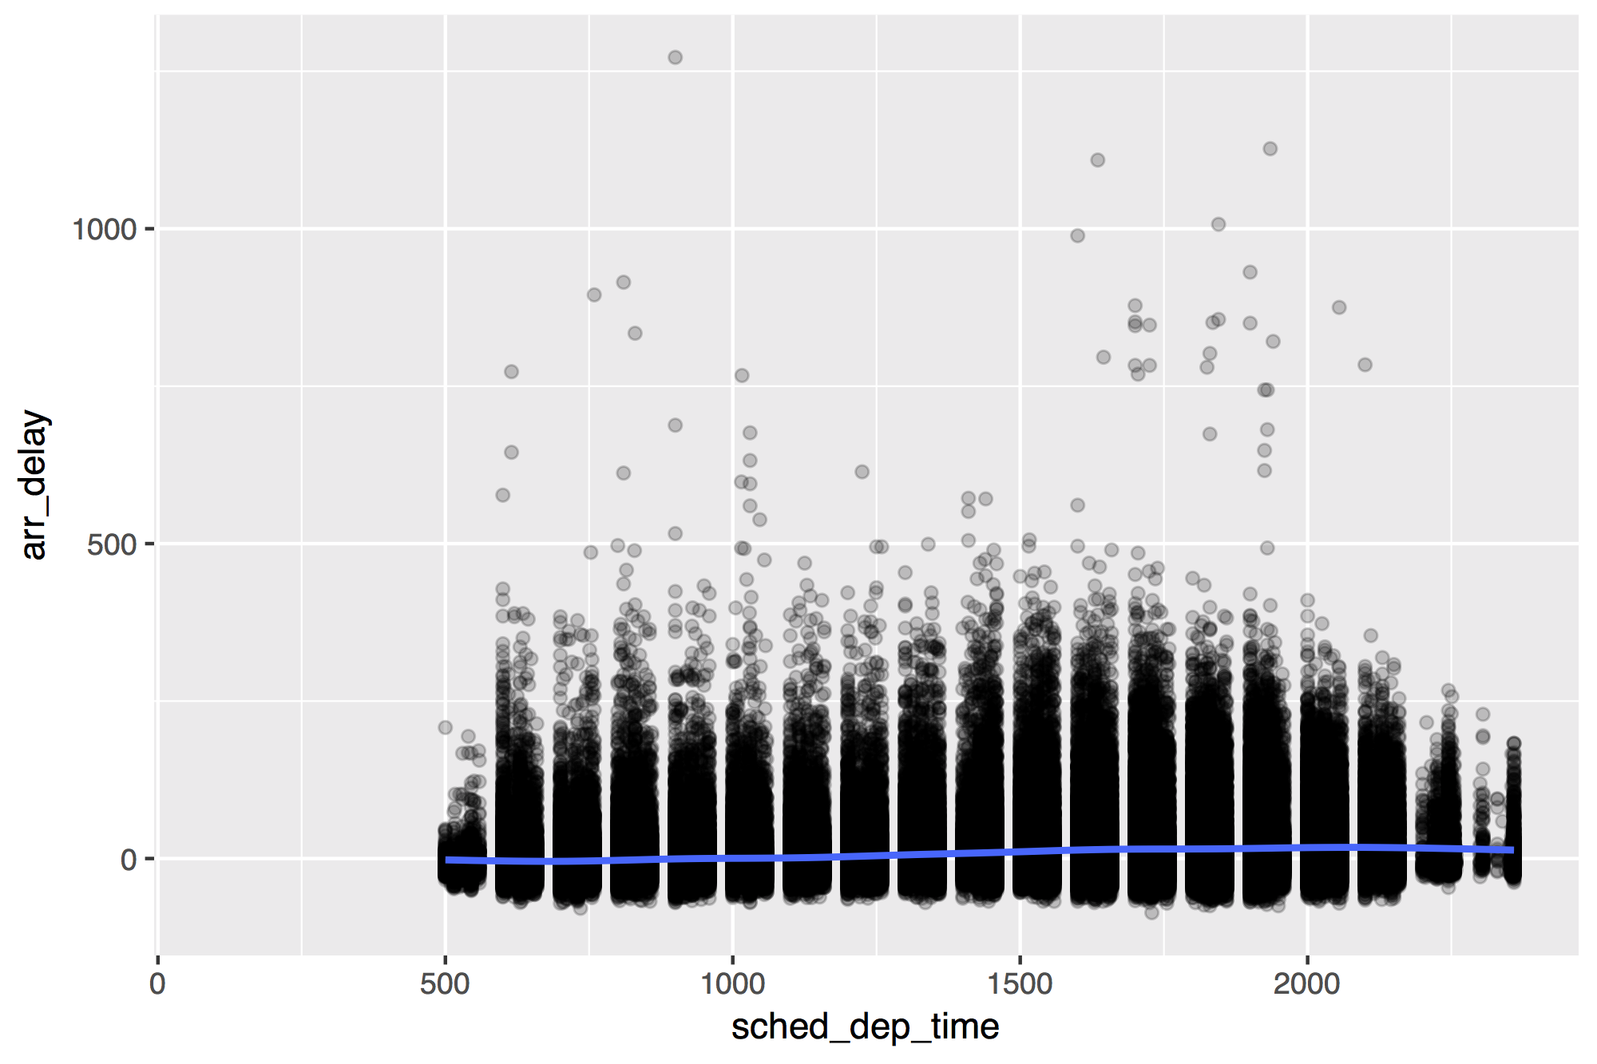
flights %>%
ggplot(mapping = aes(x = sched_dep_time, y = arr_delay)) +
geom_point(alpha = 0.2) + geom_smooth()
CC BY-SA RStudio

Slide 124
Creating dates
and times

Slide 125
What is a date time exactly?
now <- Sys.time()
now
## "2017-01-01 00:00:01 EST"
typeof(now)
## "double"
print.default(now)
## [1] 1483246801
## attr(,"tzone")
## [1] "America/New_York"
## attr(,"class")
## [1] "POSIXct" "POSIXt"
atomic vector
(double)
augmented with attributes
(tzone, class)
CC BY-SA RStudio

Slide 126
A double that R treats in a special way
print
## function (x, ...)
## UseMethod("print")
## <bytecode: 0x10c1e1f50>
## <environment: namespace:base>
class(now)
## "POSIXct" "POSIXt"
print.POSIXct(now)
## "2017-01-01 00:00:01 EST"
find the method of print for the class of x
CC BY-SA RStudio

Slide 127
Augmented vector
An atomic vector augmented with attributes, including a class, which lets R treat the contents in a specific way.
Access the attributes of an augmented vector with attributes() and attr()
attributes(now)
## $tzone
## [1] "America/New_York"
## $class
## [1] "POSIXct" "POSIXt"
attr(now, "tzone")
##"America/New_York"
CC BY-SA RStudio

Slide 128
POSIXct
2017-01-01 12:34:56
Stored as the number of seconds since 1970-01-01 00:00:00
Sys.time()
## "2017-01-01 12:34:56 EST"
unclass(Sys.time())
## 1483292096
CC BY-SA RStudio

Slide 129
Dates
2017-01-01 12:34:56
Stored as the number of days since 1970-01-01
Sys.Date()
## "2017-01-01"
unclass(Sys.Date())
## 17167
CC BY-SA RStudio

Slide 130

hms
A class for representing just clock times.
# install.packages("tidyverse")
library(hms)
CC BY-SA RStudio

Slide 131
hms
2017-01-01 12:34:56
Stored as the number of seconds since 00:00:00.*
library(hms)
hms(seconds = 56, min = 34, hour = 12)
## 12:34:56
unclass(hms(56, 34, 12))
## 45296
CC BY-SA RStudio
* on a typical day

Slide 132
hms()
2017-01-01 12:34:56
library(hms)
hms(seconds, minutes, hours, days)
CC BY-SA RStudio
* on a typical day

Slide 133
Your Turn 5
What is the best time of day to fly?
Use the hour and minute variables in flights to compute the time of day for each flight as an hms. Then use a smooth line to plot the relationship between time of day and arr_delay.

Slide 134
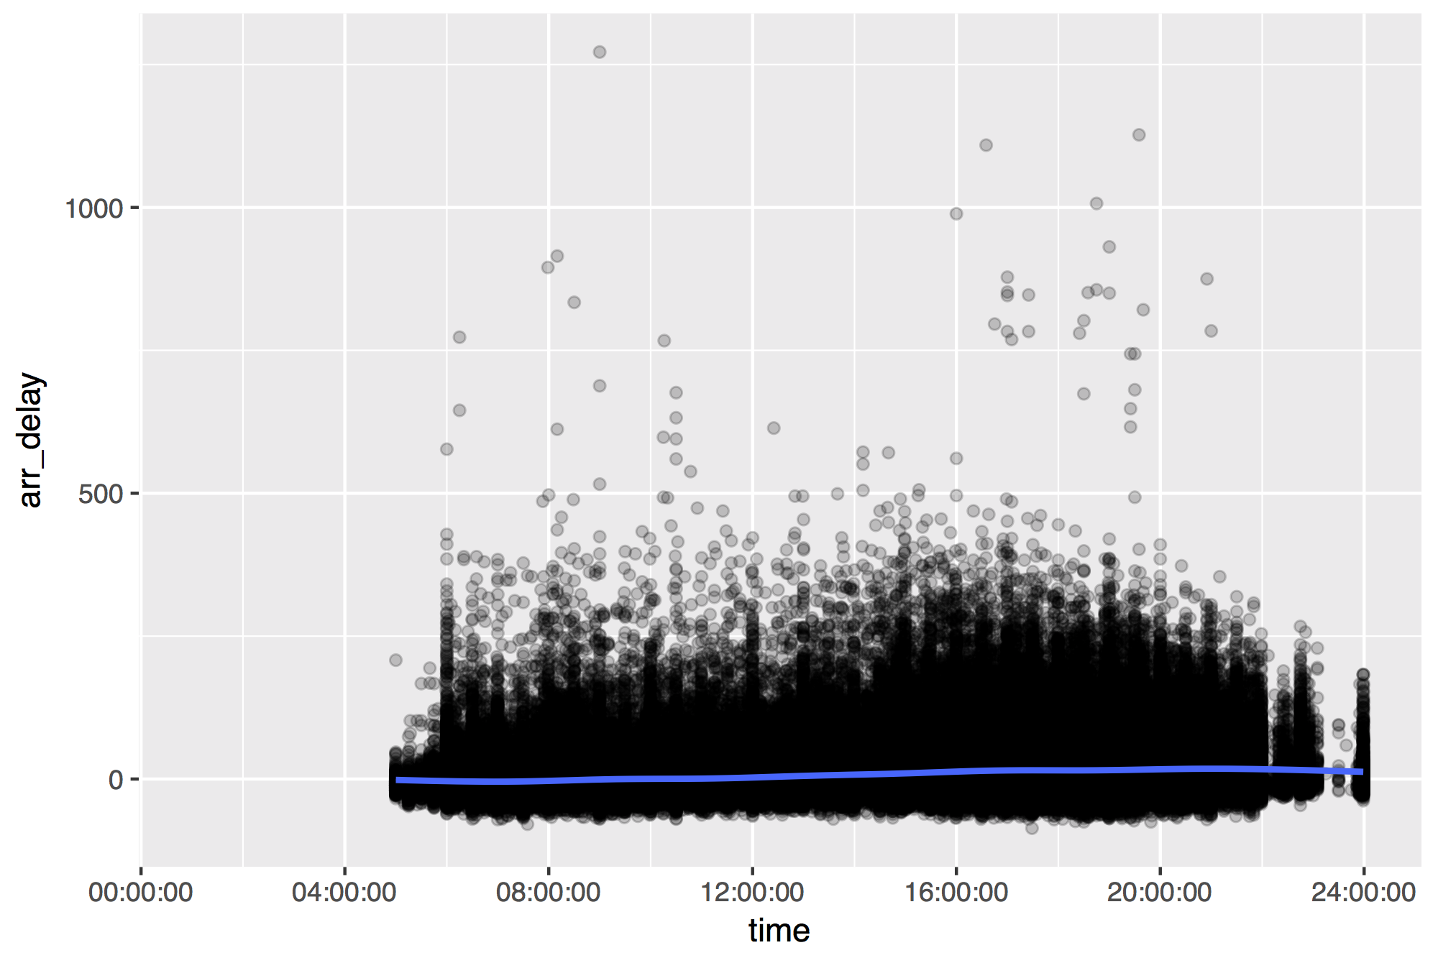
flights %>%
mutate(time = hms(hour = hour, minute = minute)) %>%
ggplot(aes(time, arr_delay)) +
geom_point(alpha = 0.2) + geom_smooth()
CC BY-SA RStudio

Slide 135
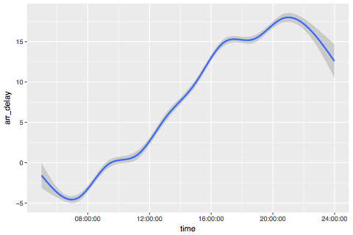
CC BY-SA RStudio

Slide 136
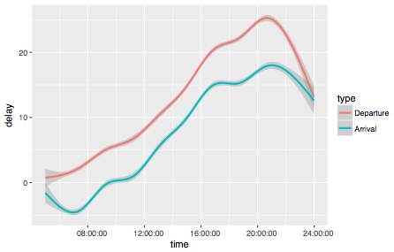
CC BY-SA RStudio

Slide 137
Challenge
Work as a group to modify your code to make the previous graph. You will need to:
Select just the time, arr_delay, and dep_delay variables
Gather the arr_delay and dep_delay columns into a key:value column pair names type and delay
Recode the delay column to contain "Departure" and "Arrival" values
Reorder the type column (which is a factor) by the time and "value" column.

Slide 138
flights %>%
mutate(time = hms::hms(hour = hour, minute = minute)) %>%
select(time, arr_delay, dep_delay) %>%
gather("type", "delay", 2:3) %>%
mutate(type = fct_recode(type,
"Arrival" = "arr_delay", "Departure" = "dep_delay"),
type = fct_reorder2(type, time, delay)) %>%
ggplot(aes(time, delay, color = type)) + geom_smooth()
CC BY-SA RStudio

Slide 139
lubridate
Functions for working with dates and time spans
# install.packages("tidyverse")
library(lubridate)
CC BY-SA RStudio

Slide 140
ymd() family
To parse strings as dates, use a y, m, d, h, m, s combo
ymd("2017/01/11")
mdy("January 11, 2017")
ymd_hms("2017-01-11 01:30:55")
CC BY-SA RStudio

Slide 141
Parsing functions
function | parses to
ymd_hms(), ymd_hm(), ymd_h()
ydm_hms(), ydm_hm(), ydm_h() | POSIXct
dmy_hms(), dmy_hm(), dmy_h()
mdy_hms(), mdy_hm(), mdy_h()
ymd(), ydm(), mdy() | Date (POSIXct if tz specified)
myd(), dmy(), dym(), yq()
hms(), hm(), ms() | Period
CC BY-SA RStudio

Slide 142
ymd() family
To parse strings as dates, use a y, m, d, h, m, s combo
ymd_hms("2017-01-01T12:34:56")
## "2017-01-01 12:34:56 UTC"
ymd_hm("2017/01/01 12:34")
## "2017-01-01 12:34:56 UTC"
dmy("2 January 17")
## "2017-01-02"
ms("34 56")
## "34M 56S"
lubridate functions are separator agnostic
CC BY-SA RStudio

Slide 143
ISO 8601
You say “To-may-to”: MM/DD/YYYY
I say “To-mah-to”: DD/MM/YYYY
ISO 8601 says: YYYY-MM-DDTHH:MM:SS+00:00
CC BY-SA RStudio

Slide 144
Accessing
and changing components

Slide 145
Accessing components
Extract components by name with a singular name
date <- ymd("2017-01-11")
year(date)
## 2017
CC BY-SA RStudio

Slide 146
Setting components
Use the same function to set components
date
## "2017-01-11"
year(date) <- 1999
date
## "1999-01-11"
CC BY-SA RStudio

Slide 147
Accessing date time components
function | extracts | extra arguments
year() | year
month() | month | label = FALSE, abbr = TRUE
week() | week
day() | day of month
wday() | day of week | label = FALSE, abbr = TRUE
qday() | day of quarter
yday() | day of year
hour() | hour
minute() | minute
second() | second
CC BY-SA RStudio

Slide 148
Accessing components
wday(ymd("2017-01-11"))
## 3
wday(ymd("2017-01-11"), label = TRUE)
## [1] Wed
## 7 Levels: Sun < Mon < Tues < Wed < Thurs < ... < Sat
wday(ymd("2017-01-11"), label = TRUE, abbr = FALSE)
## [1] Sunday
## 7 Levels: Sunday < Monday < Tuesday < ... < Saturday
CC BY-SA RStudio

Slide 149
Your Turn 6
Fill in the blanks to:
Extract the day of the week of each flight (as a full name) from time_hour.
Calculate the average arr_delay by day of the week.
Plot the results as a column chart (bar chart) with geom_col().

Slide 150
flights %>%
mutate(weekday = wday(time_hour, label = TRUE, abbr = FALSE)) %>%
group_by(weekday) %>%
drop_na(arr_delay) %>%
summarise(avg_delay = mean(arr_delay)) %>%
ggplot() +
geom_col(mapping = aes(x = weekday, y = avg_delay))
CC BY-SA RStudio

Slide 151
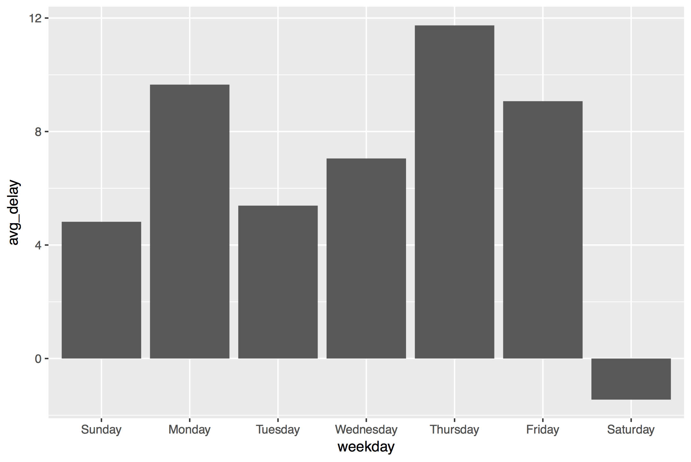
CC BY-SA RStudio

Slide 152
month names
month.name[1,2,3]
# [1] "January" "February" "March"
month.abb[1,2,3]
[1] "Jan" "Feb" "Mar"
CC BY-SA RStudio

Slide 153
Parsing functions
function | parses to
ymd_hms(), ymd_hm(), ymd_h()
ydm_hms(), ydm_hm(), ydm_h() | POSIXct
dmy_hms(), dmy_hm(), dmy_h()
mdy_hms(), mdy_hm(), mdy_h()
ymd(), ydm(), mdy() | Date (POSIXct if tz specified)
myd(), dmy(), dym(), yq()
hms(), hm(), ms() | Period
CC BY-SA RStudio

Slide 154
Parsing functions
function | parses to
ymd_hms(), ymd_hm(), ymd_h()
ydm_hms(), ydm_hm(), ydm_h() | POSIXct
dmy_hms(), dmy_hm(), dmy_h()
mdy_hms(), mdy_hm(), mdy_h()
ymd(), ydm(), mdy() | Date (POSIXct if tz specified)
myd(), dmy(), dym(), yq()
hms(), hm(), ms() | Period
Same name as
hms() in hms
CC BY-SA RStudio

Slide 155
hms::hms()
package name
function name
CC BY-SA RStudio
* on a typical day

Slide 156
hms::hms()
lubridate::hms()
CC BY-SA RStudio
* on a typical day

Slide 157
hms()
hms::hms(seconds = 3, hours = 5)
Use the
hms() function in the hms package
CC BY-SA RStudio
* on a typical day

Slide 158
Dealing with time zones

Slide 159
Quiz
How many time zones are there?

Slide 160
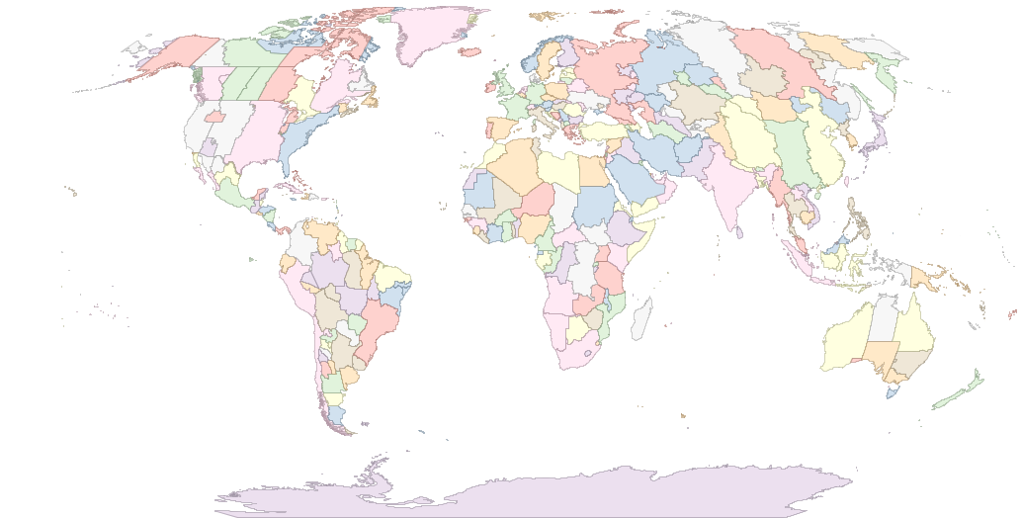
589
CC BY-SA RStudio

Slide 161
Time zone names
OlsonNames()
## "Africa/Abidjan"
## "Africa/Accra"
## "Africa/Addis_Ababa"
## "Africa/Algiers"
## "Africa/Asmara"
## …
## 589 total
CC BY-SA RStudio

Slide 162
Quiz
What is the "benchmark" time zone?

Slide 163
Quiz
What is the "benchmark" time zone?
GMT?
UTC

Slide 164
ymd() family
Lubridate functions use UTC by default
ymd_hms(…, tz = "UTC")
CC BY-SA RStudio

Slide 165
Quiz
nyc <- now(tz = "America/New_York")
la <- now(tz = "America/Los_Angeles")
coasts <- c(nyc, la)
What is the time zone of coasts?

Slide 166
!
R stores time zones as an attribute, which means that:
every datetime in a vector must share the same time zone
time zones are frequently dropped
CC BY-SA RStudio

Slide 167
Quiz
What time should this return? Decide in your group.
nyc <- ymd_hms("2017-01-01 00:00:00",
tz = "America/New_York")
tz(nyc) <- "America/Los_Angeles"

Slide 168
with_tz()
Creates same instant with the new display
with_tz(t,
tz = "America/Denver")
## "2017-01-05 02:00:00 MST"
with_tz(t,
tz = "America/Chicago")
## "2017-01-05 03:00:00 CST"
t <- now(
tz = "America/Los_Angeles")
## "2017-01-05 01:00:00 PST"
with_tz(t,
tz = "America/New_York")
## "2017-01-05 04:00:00
CC BY-SA RStudio

Slide 169
force_tz()
Creates same instant with the new display
force_tz(t,
tz = "America/Denver")
## "2017-01-05 01:00:00
force_tz(t,
tz = "America/Chicago")
## "2017-01-05 01:00:00
t <- now(
tz = "America/Los_Angeles")
## "2017-01-05 01:00:00 PST"
force_tz(t,
tz = "America/New_York")
## "2017-01-05 01:00:00
CC BY-SA RStudio

Slide 170
Your Turn
this_instant <- now()
What time is it in Honolulu (Pacific/Honolulu) this instant?
What will it be here when Honolulu clocks show our time?
The time_hour column of flights is saved as UTC. Convert it to the correct time zone for New York City. Notice that the hours element of time_hour already matches flights$hour, which is ostensibly the correct hour in the America/New_York time zone.

Slide 171
this_instant %>%
with_tz("Pacific/Honolulu")
this_instant %>%
force_tz("Pacific/Honolulu") %>%
with_tz("America/New_York")
flights %>%
mutate(time_hour = with_tz(time_hour, "America/New_York")) %>%
select(time_hour)
CC BY-SA RStudio

Slide 172
Doing math with dates and times

Slide 173
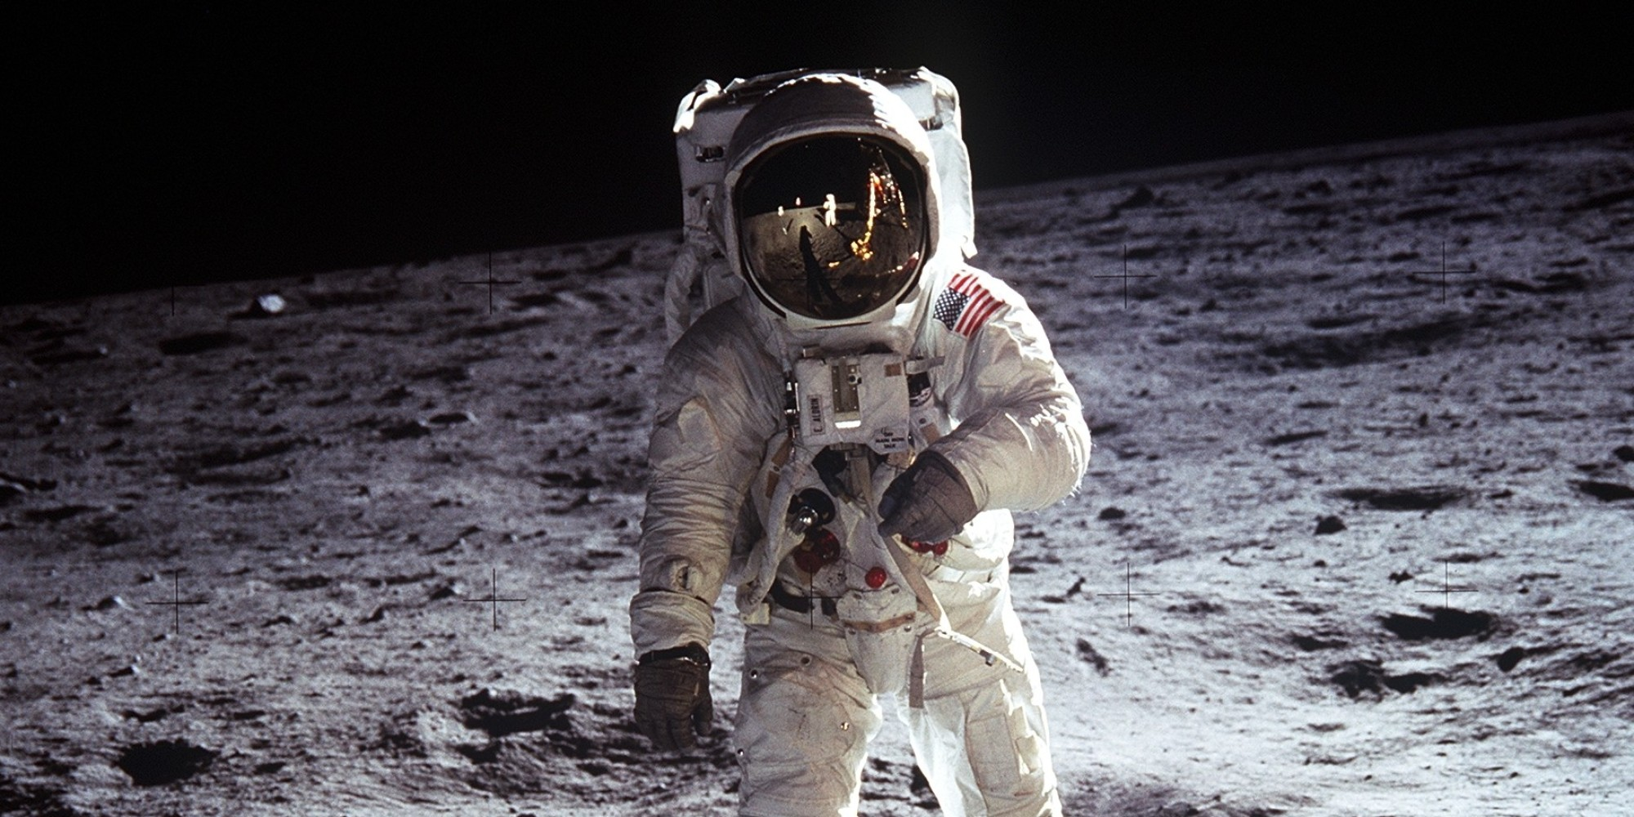
20 July, 1969
CC BY-SA RStudio

Slide 174
Nov, 25 1992
03 Oct, 1993
Mike K Smith joins Pfizer, Sandwich
CC BY-SA RStudio

Slide 175
difftimes
When you subtract two dates in R you get a difftime
now() - as.POSIXct(today())
## Time difference of 22.29285 hours
But difftimes use inconsistent units (sometimes weeks, days, hours, minutes, or seconds…)
CC BY-SA RStudio

Slide 176
durations
A time span that is always measured in seconds
as.duration(today() - MKS)
## "825897600s (~26.17 years)"
as.duration(MKS - moon_landing)
## "763862400s (~24.21 years)"
Plus, a better display
CC BY-SA RStudio

Slide 177
Math with dates
To do math with dates add and subtract periods
weeks(1) - days(3) + hours(2)
## "4d 2H 0M 0S"
today() + months(0:11)
## "2017-01-01" "2017-02-01" "2017-03-01"
## "2017-04-01" "2017-05-01" "2017-06-01"
## "2017-07-01" "2017-08-01" "2017-09-01"
## "2017-10-01" "2017-11-01" "2017-12-01"
CC BY-SA RStudio

Slide 178
Period constructors
function | makes
years(x) | x years
months(x) | x months
weeks(x) | x weeks
days(x) | x days
hours(x) | x hours
minutes(x) | x minutes
seconds(x) | x seconds
milliseconds(x) | x milliseconds
microseconds(x) | x microseconds
nanoseconds(x) | x nanoseconds
picoseconds(x) | x picoseconds
CC BY-SA RStudio

Slide 179
Quiz
What might worry us here?
as.POSIXct("2019-03-29 08:00:00") + days(1)
## "2019-03-30 08:00:00 GMT"
as.POSIXct("2019-03-30 08:00:00") + days(1)

Slide 180
periods
A time span that is measured in clock units
as.POSIXct("2019-03-29 08:00:00") + days(1)
## "2019-03-30 08:00:00 GMT"
as.POSIXct("2019-03-30 08:00:00") + days(1)
## "2019-03-31 08:00:00 BST"
CC BY-SA RStudio

Slide 181
durations
If absolute time matters, use seconds or a duration
as.POSIXct("2019-03-29 08:00:00") + ddays(1)
## "2019-03-30 08:00:00 GMT"
as.POSIXct("2019-03-30 08:00:00") + ddays(1)
## "2019-03-31 09:00:00 BST"
CC BY-SA RStudio

Slide 182
Duration constructors
function | makes
dyears(x) | x years
dweeks(x) | x weeks
ddays(x) | x days
dhours(x) | x hours
dminutes(x) | x minutes
dseconds(x) | x seconds
dmilliseconds(x) | x milliseconds
dmicroseconds(x) | x microseconds
dnanoseconds(x) | x nanoseconds
dpicoseconds(x) | x picoseconds
CC BY-SA RStudio

Slide 183
Quiz
What should this return? Decide in your group.
months(1) / days(1)

Slide 184
Math with periods
months(1) / days(1)
## estimate only: convert to intervals for accuracy
## 30.4375
CC BY-SA RStudio

Slide 185
Quiz
Can we calculate something like this accurately?
"The month between Jan 1, 2017 and Feb 1, 2017" /days(1)

Slide 186
intervals
A time span that is measured by start and end dates
interval(mdy("Jan 1, 2017"), mdy("Feb 1, 2017"))
## 2017-01-01 UTC--2017-02-01 UTC
mdy("Jan 1, 2017") %--% mdy("Feb 1, 2017")
## 2017-01-01 UTC--2017-02-01 UTC
CC BY-SA RStudio

Slide 187
Divide by periods and durations to compute the length
month1 <- mdy("Jan 1, 2017") %--% mdy("Feb 1, 2017")
month1 / days(1)
## 31
CC BY-SA RStudio

Slide 188
Working with intervals
function | makes
int_start() | access or change the start date
int_end() | access or change the end date
int_diff() | intervals between dates in a vector
int_length() | number of seconds in the interval
int_flip() | switches start and end dates of th interval
int_shift() | shifts an interval by a time span
int_standardize() | flips interval is length is negative
int_aligns(x) | tests whether interval begin or end on same instant
int_overlaps() | tests whether intervals overlap
intersect(), union(), setdiff() | set operations for intervals
%within% | tests whether instants fall within an interval
CC BY-SA RStudio

Slide 189
%within%
Tests whether instants fall within an interval
firsts <- ymd("2017-01-01") + months(0:11)
summer <- ymd("2017-06-21") %--% ymd("2017-09-21")
firsts %within% summer
## FALSE FALSE FALSE FALSE FALSE FALSE
## TRUE TRUE TRUE FALSE FALSE FALSE
CC BY-SA RStudio

Slide 190
Your Turn
Are flight delays worse over the holidays?
NYC Public Schools held winter recess from December 23, 2013 to January 1, 2014. Create an interval that captures the recess.
Complete the code below to plot delays over time during recess vs. the rest of the year
flights %>%
mutate(during_recess = _____________________________,
time = hms::hms(hour = hour, minute = minute)) %>%
ggplot(aes(time, dep_delay, color = during_recess)) +
geom_smooth()

Slide 191
recess <- ymd("2013-12-23") %--% ymd("2014-01-01")
flights %>%
mutate(during_recess = time_hour %within% recess,
time = hms::hms(hour = hour, minute = minute)) %>%
ggplot(aes(time, dep_delay, color = during_recess)) +
geom_smooth()
CC BY-SA RStudio

Slide 192
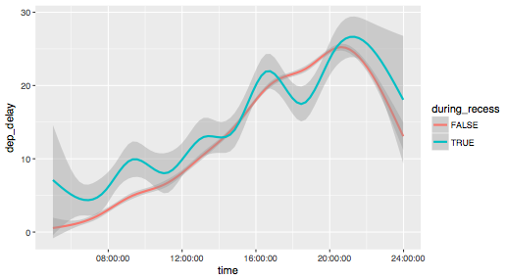
CC BY-SA RStudio

Slide 193
Math with instants
Instant
Time span
Instant
Instant
Time span
?
CC BY-SA RStudio

Slide 195
R object types (a brief scamper)

Slide 196

Vector
type
Must have consistent types
CC BY-SA RStudio

Slide 197
Vector
"one"
"two"
"three"
character
myVector <- c("one", "two", "three")
CC BY-SA RStudio

Slide 198
Vector
1
2
3
double
myVector <- c(1, 2, 3)
CC BY-SA RStudio

Slide 199
Vector
TRUE
FALSE
FALSE
logical
myVector <- c(TRUE, FALSE, FALSE)
CC BY-SA RStudio

Slide 200
Scalar
type
Vector with length = 1
myScalar <- 1
myScalar <- myVector[1]
R indices start at 1
Extract elements with [ ]
CC BY-SA RStudio

Slide 201
Vector
CC BY-SA RStudio

Slide 202
Matrix
1
3
5
2
4
6
Vector with dimensions: rows, columns
myVector <- c(1,2,3,4,5,6)
myMatrix <- matrix(myVector, nrow=2, ncol=3)
CC BY-SA RStudio

Slide 203
Matrix
1
2
3
4
5
6
Vector with dimensions: rows, columns
myVector <- c(1,2,3,4,5,6)
myMatrix <- matrix(myVector, nrow=2, ncol=3, byrow=TRUE)
CC BY-SA RStudio

Slide 204
Array
Vector with >= 2 dimensions
myVector <- c(1,2,3,4,5,6)
myArray <- array(myVector, dim=c(2,3))
CC BY-SA RStudio

Slide 205
Vector
1
"one"
FALSE
?
CC BY-SA RStudio

Slide 206
Vector
"1"
"one"
"FALSE"
character
CC BY-SA RStudio

Slide 207


Vector
1
"one"
FALSE
List
1
double
1
"one"
character
FALSE
logical
CC BY-SA RStudio

Slide 208
List
data frame
num | cha | log
1 | "one" | TRUE
2 | "two" | FALSE
3 | "three" | FALSE
1
2
3
double
=
"one"
"two"
"three"
character
TRUE
FALSE
FALSE
logical
+ class = "data.frame"
CC BY-SA RStudio

Slide 209
data frame
df["num"]
df[["num"]]
num | cha | log
1 | "one" | TRUE
2 | "two" | FALSE
3 | "three" | FALSE
num
1
2
3
df$num
c(1, 2, 3)
CC BY-SA RStudio

Slide 210
List
1
double
1
"1"
"two"
"FALSE"
character
FALSE
logical
CC BY-SA RStudio

Slide 211
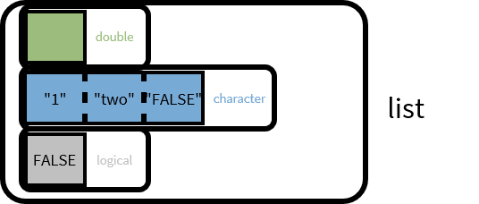
List
1
double
1
"1"
"two"
"FALSE"
character
1
double
list
"1"
"two"
"FALSE"
character
It's lists all the way down
double
"1"
"two"
"FALSE"
character
list
CC BY-SA RStudio

Slide 212
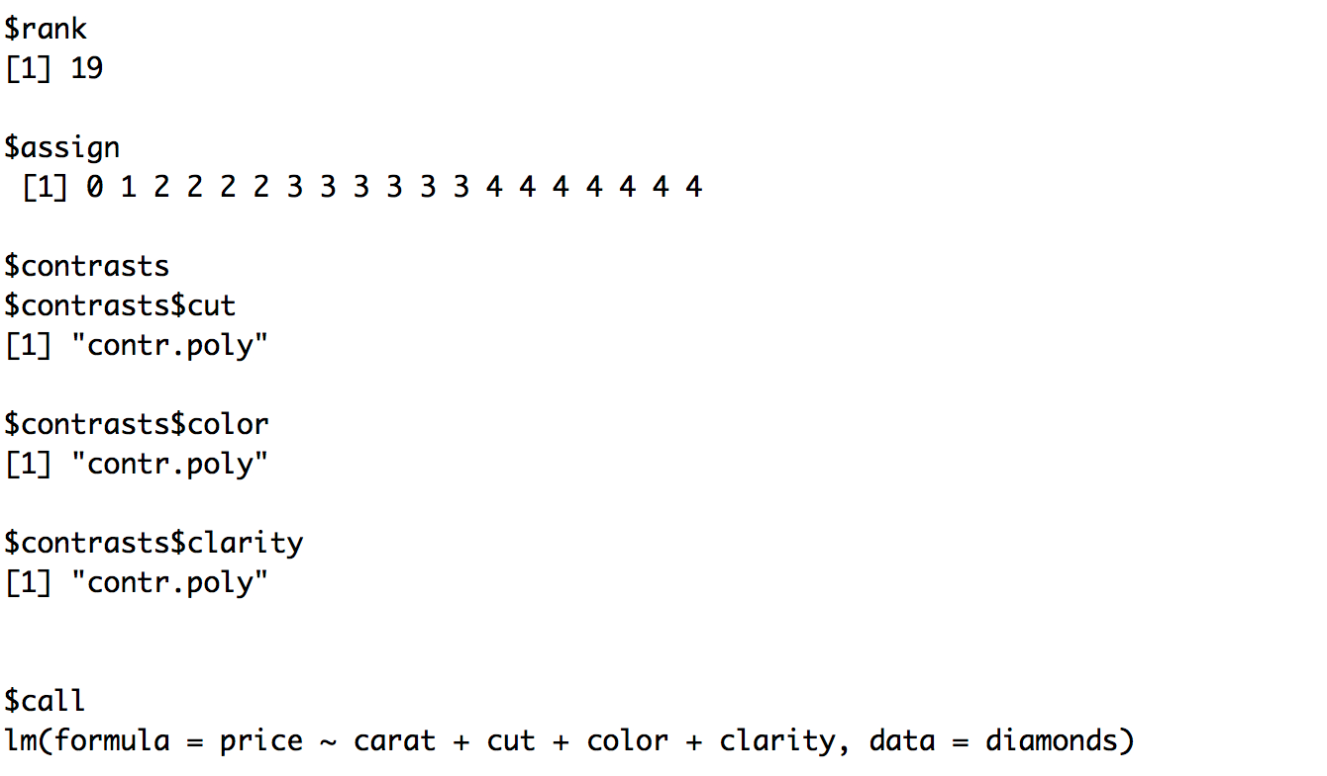

Partial output of fitting the linear model
lm(price ~ carat + cut + color + clarity, data = diamonds)
CC BY-SA RStudio

Slide 213
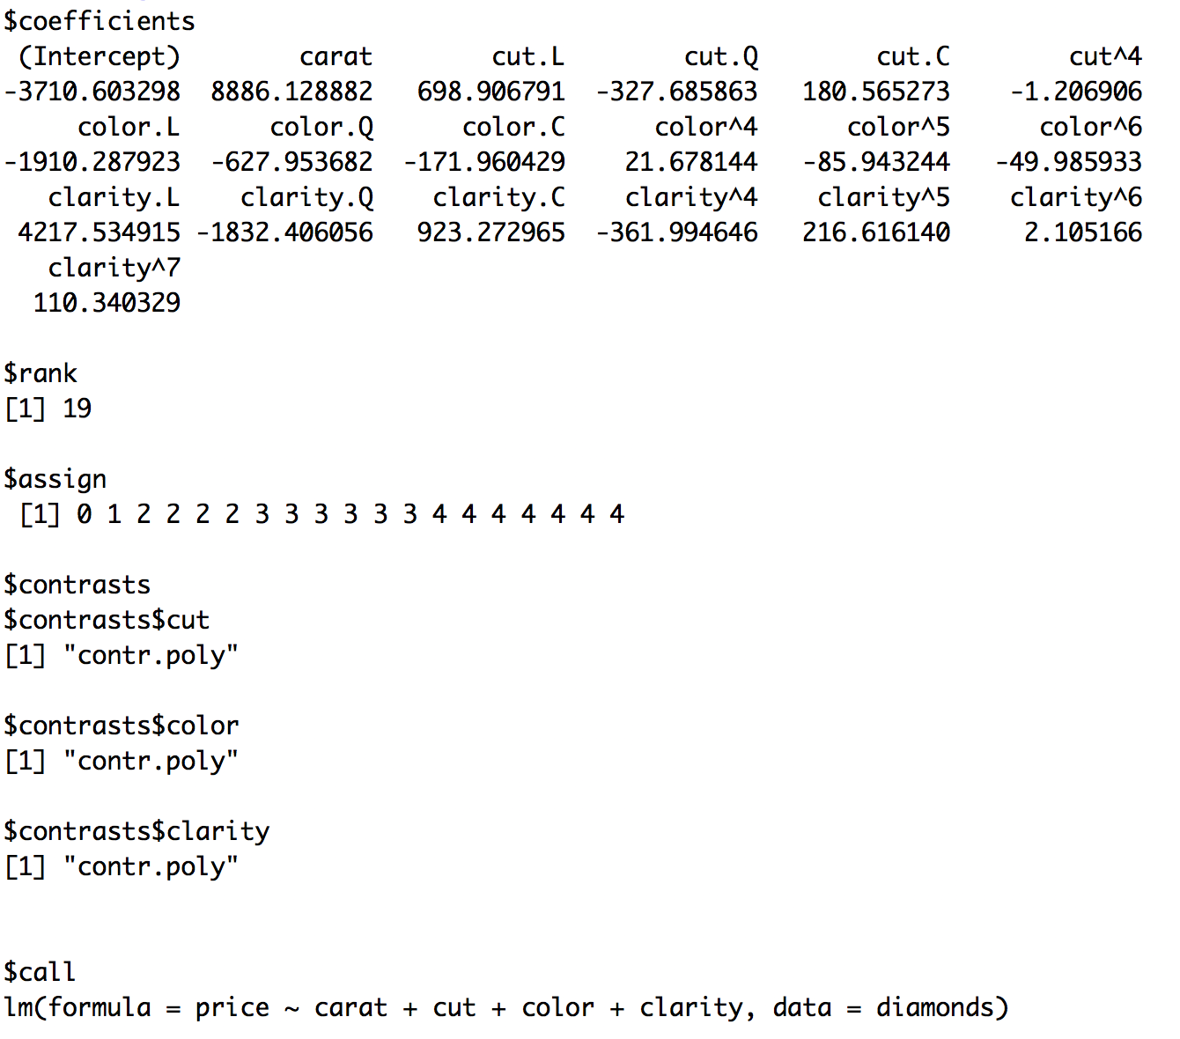
CC BY-SA RStudio

Slide 214
More detail
http://adv-r.had.co.nz/Data-structures.html

Slide 215
Your Turn 1
Here is a list:
a_list <- list(num = c(8, 9),
log = TRUE,
cha = c("a", "b", "c"))
Here are two subsetting commands. Do they return the same values? Run the code chunks to confirm
a_list["num"]
a_list$num

Slide 216
a_list["num"]
$num
[1] 8 9
A list
(with one element named num that contains an atomic vector)
a_list$num
[1] 8 9
An atomic vector
CC BY-SA RStudio

Slide 217
num
log
cha
lst
c(8, 9)
TRUE
c("a", "b", "c")
lst <- list(num = c(8,9), log = TRUE, cha = c("a", "b", "c"))
CC BY-SA RStudio

Slide 218
num
log
cha
c(8, 9)
TRUE
c("a", "b", "c")
num
c(8, 9)
lst["num"]
CC BY-SA RStudio

Slide 219
num
log
cha
c(8, 9)
TRUE
c("a", "b", "c")
num
c(8, 9)
lst["num"]
lst[["num"]]
c(8, 9)
CC BY-SA RStudio

Slide 220
num
log
cha
c(8, 9)
TRUE
c("a", "b", "c")
num
c(8, 9)
lst["num"]
lst[["num"]]
c(8, 9)
lst$num
c(8, 9)
CC BY-SA RStudio

Slide 221
Your Turn 2
What will each of these return? Run the code chunks to confirm.
vec <- c(-2, -1, 0, 1, 2)
abs(vec)
lst <- list(-2, -1, 0, 1, 2)
abs(lst)
# 2 1 0 1 2
# Error in abs(lst) :
# non-numeric argument to mathematical function

Slide 222
Take aways
Lists are a useful way to organize data.
But you need to arrange manually for functions to iterate over the elements of a list.
CC BY-SA RStudio

